Slide 1
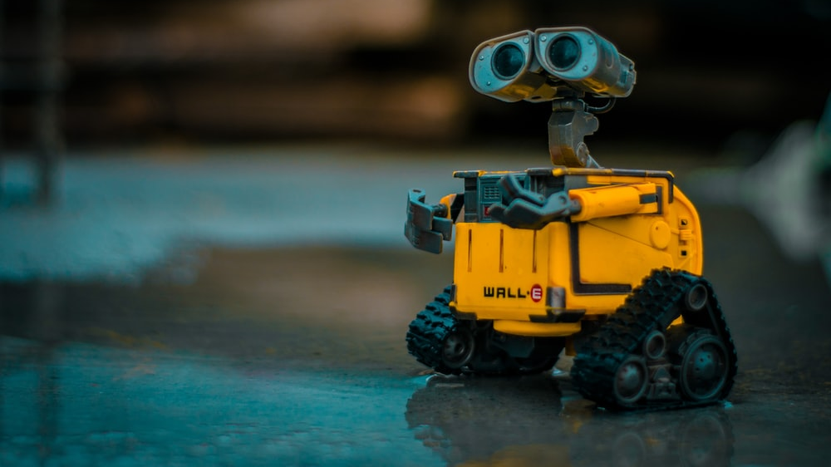
# ImageClassificationBot
#hashtag
# LimorNunu
# AvivKadair
# RonZehavi
# DanaMakov

Slide 2
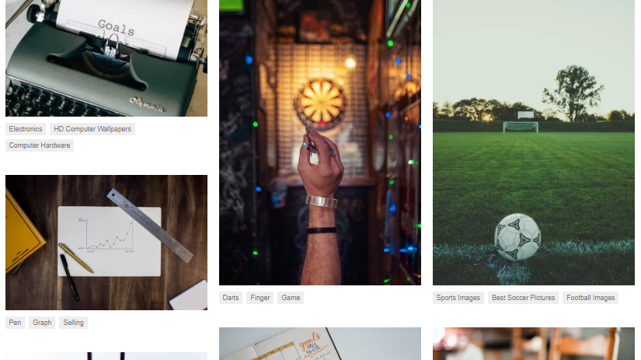
Our goal
Predict associated hashtags for images

Slide 3

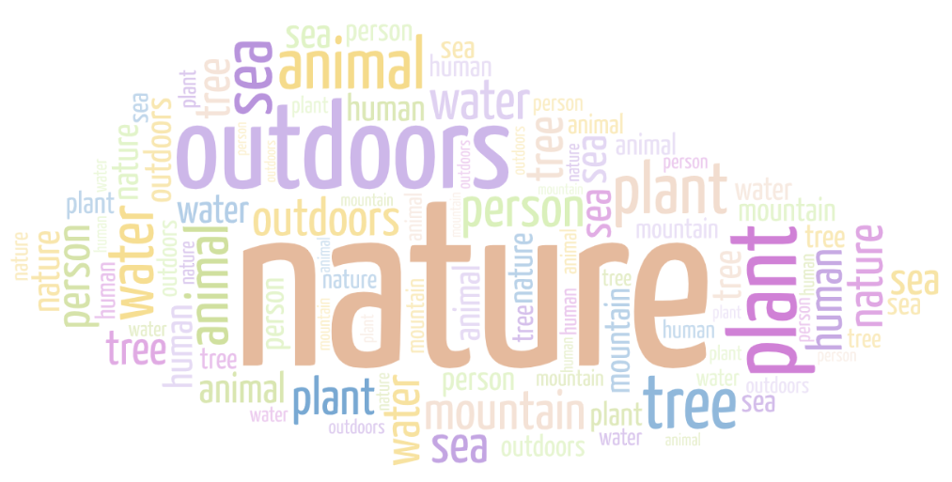
Unsplash
Full dataset - 2M+ high resolution images
Lite dataset - 25k nature-themed photos
Our dataset - 13k links for high resolution images
https://unsplash.com

Slide 4
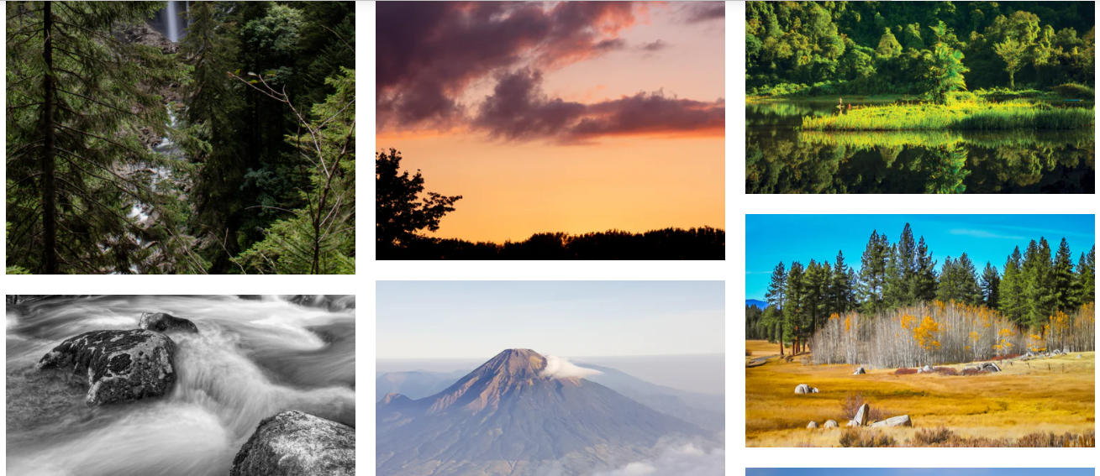
Challenges:
Solutions:
Label quality inconsistent
Extract only 10 most common keywords with a confidence interval of 99%
Download image data without saving to disk each image
Use urllib and NumPy to extract the pixel array for each image
Varying sizes and color format
Adjust all images to 224*224 size and RGB format
Unsplash

Slide 5
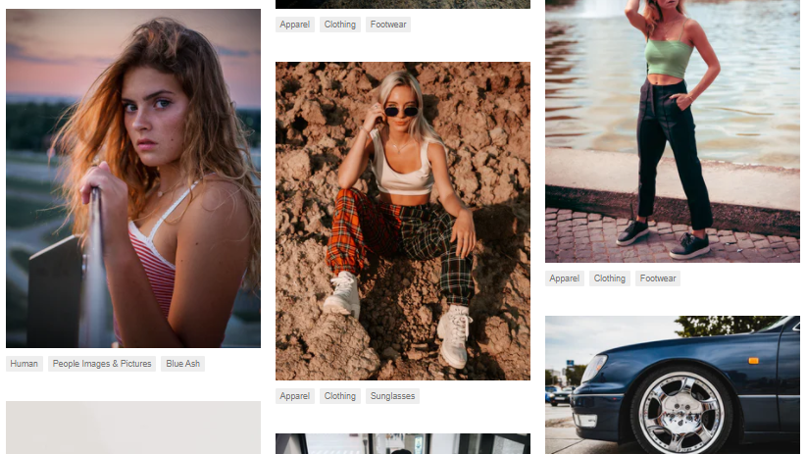
Models

Slide 6
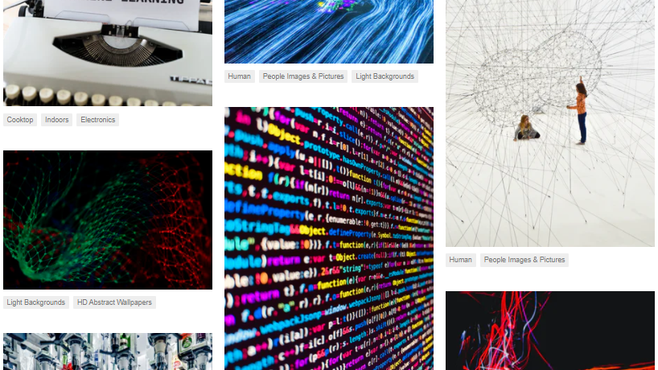
VGG16
A super-deep neural network
16 weight layers
Obtains good results
But at what price?
- Slow & heavy to train

Slide 7
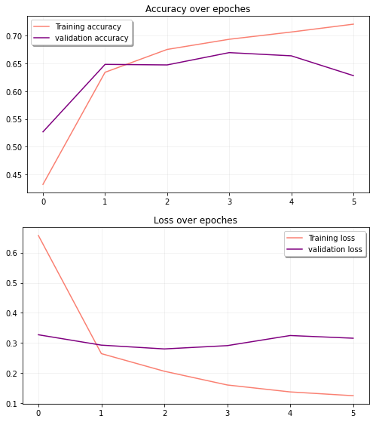

VGG16

Slide 8
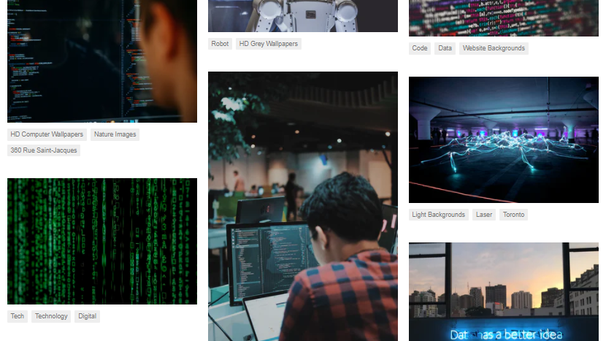
Inception V3
Multiple modules of convolutions
Weighs about 75% less than VGG16
What about accuracy?

Slide 9
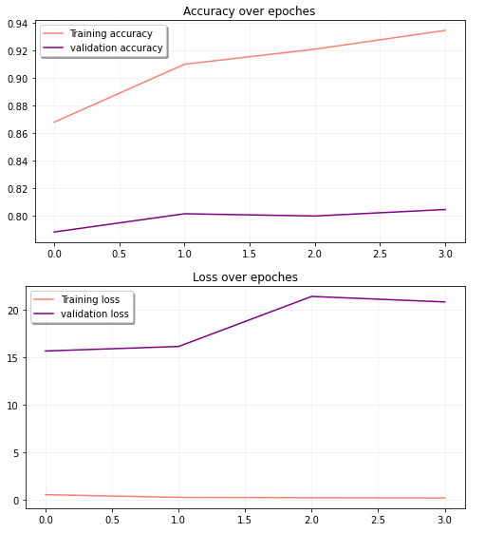
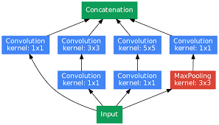
Inception V3

Slide 10
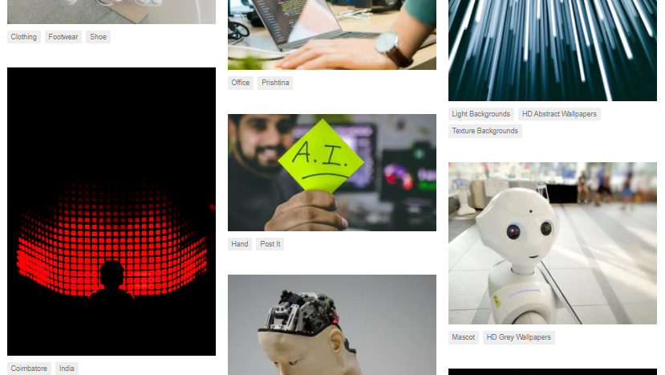
Xception
Builds on the Inception architecture
perform 1×1 convolution first then channel-wise spatial convolution.
Weighs about 90 MB!

Slide 11
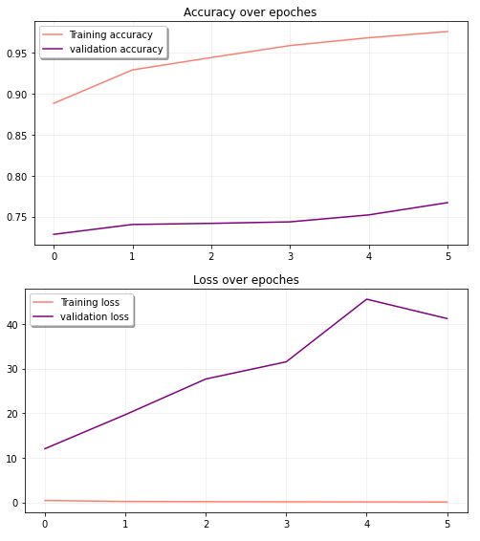
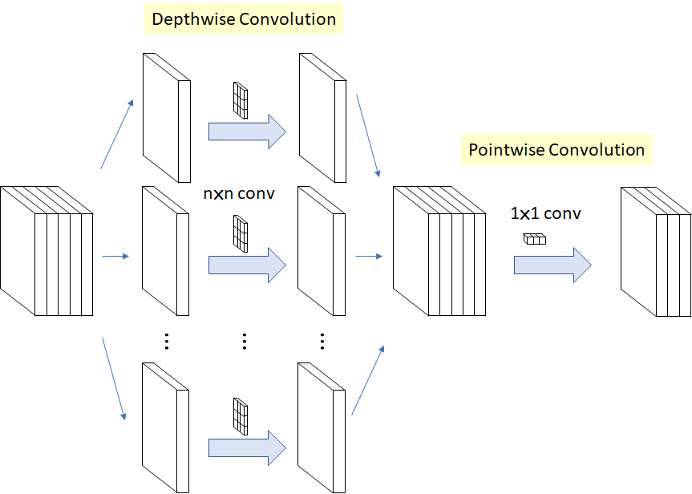
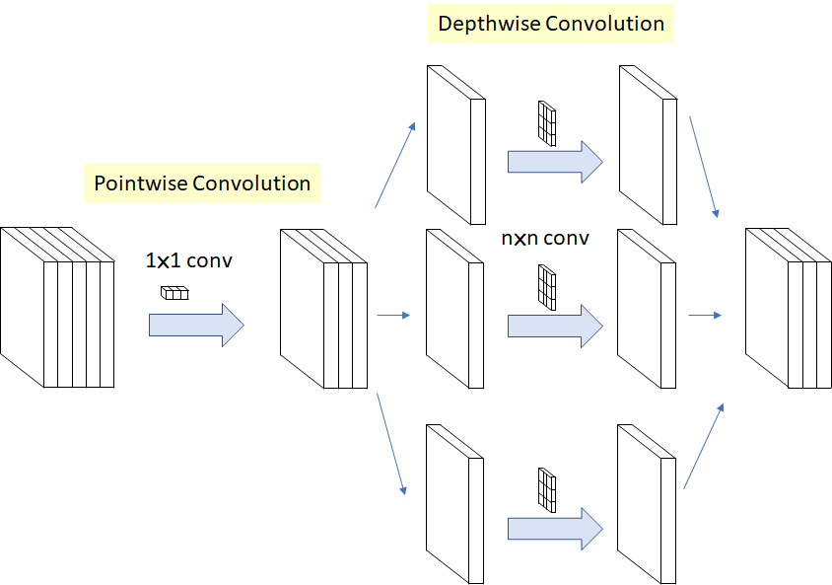
Xception

Slide 12

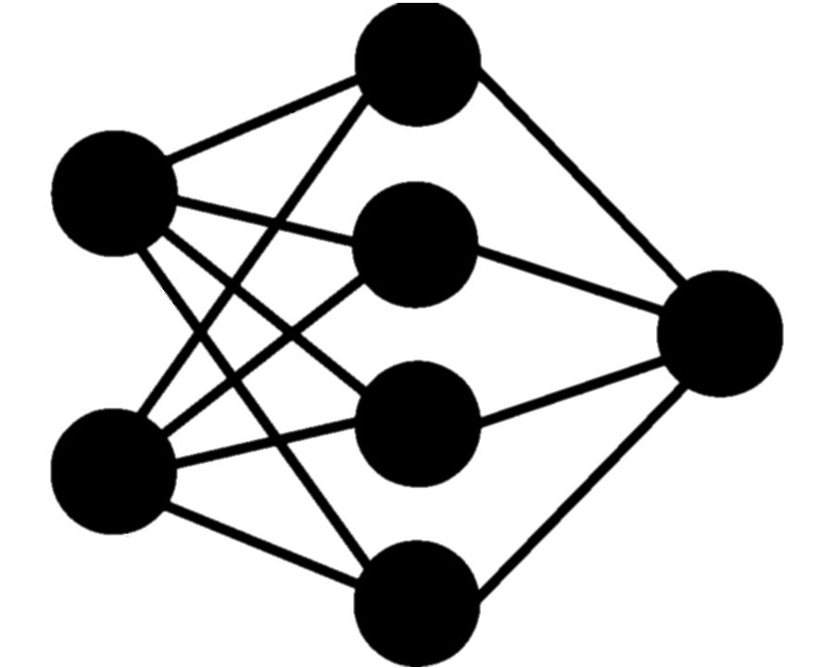



Results
MODEL
VGG16 InceptionV3
XCeption
ACCURACY
68% 80%
76%
SIZE - parameters
Trainable: ~ 3.2M
Non-trainable: ~ 14.7M
Trainable: ~ 6.5M
Non-trainable: ~ 21.8M
Trainable: ~ 12.8M
Non-trainable: ~ 20.8M
LOSS - binary_crossentropy
~ 0.3 ~ 20
~ 41

Slide 13
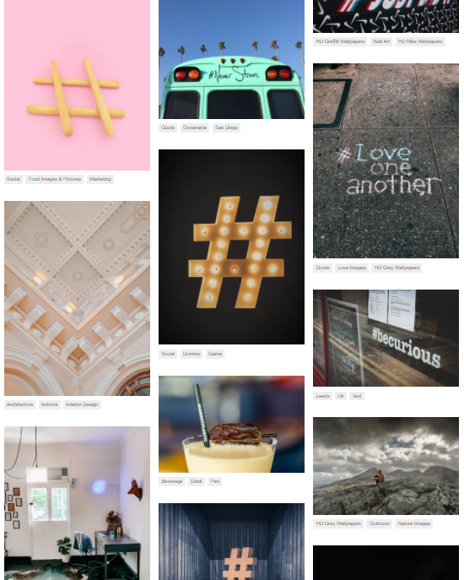
#hashtag
Chris Messina, a web marketing specialist, is the inventor of the hashtag.
The first-ever hashtag was #barcamp, sent by Messina in 2007.
The word “hashtag” was officially added to the Oxford English Dictionary in 2014.
Source: https://comparecamp.com/hashtags-statistics

Slide 14
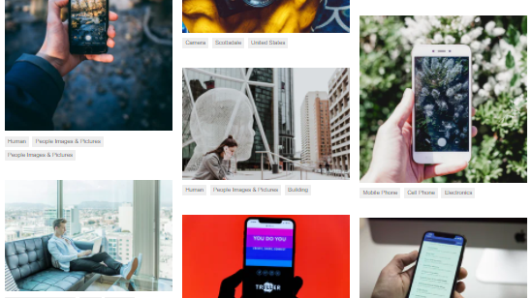
Top Hashtag
125 million
The average hashtags tweeted daily is...
#TheWalkingDead
The most-tweeted TV hashtag is…
#StarWars
The most-tweeted movie hashtag is…
The most tweeted about sports league is…
#NFL
1 billion times
The hashtag #NowPlaying (or #np) has been tweeted more than...
Source: https://comparecamp.com/hashtags-statistics

Slide 15
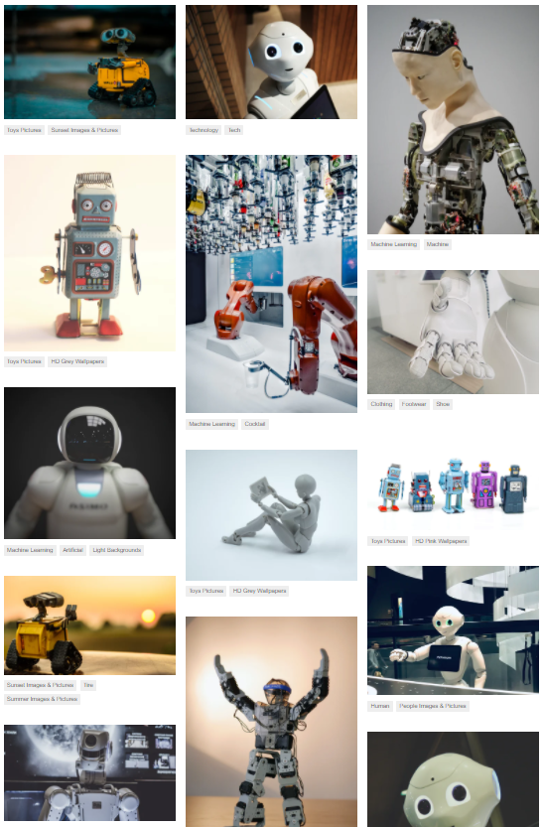


The Bot
Live Demo:
https://t.me/Pic_hashtag_bot

Slide 16
The Bot
Live Demo:
https://t.me/Pic_hashtag_bot
Try it by yourself, the link will be in the chat ☺

Slide 17

Next Steps
Web scraping from Instagram
29%
79.5%
More interactions for posts with at least 1 hashtag
More interactions for posts with 11 hashtag

Slide 18
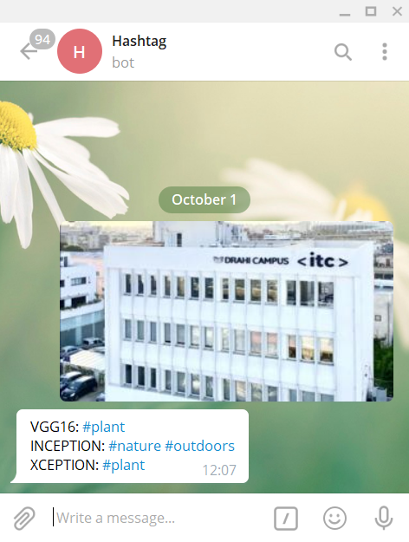


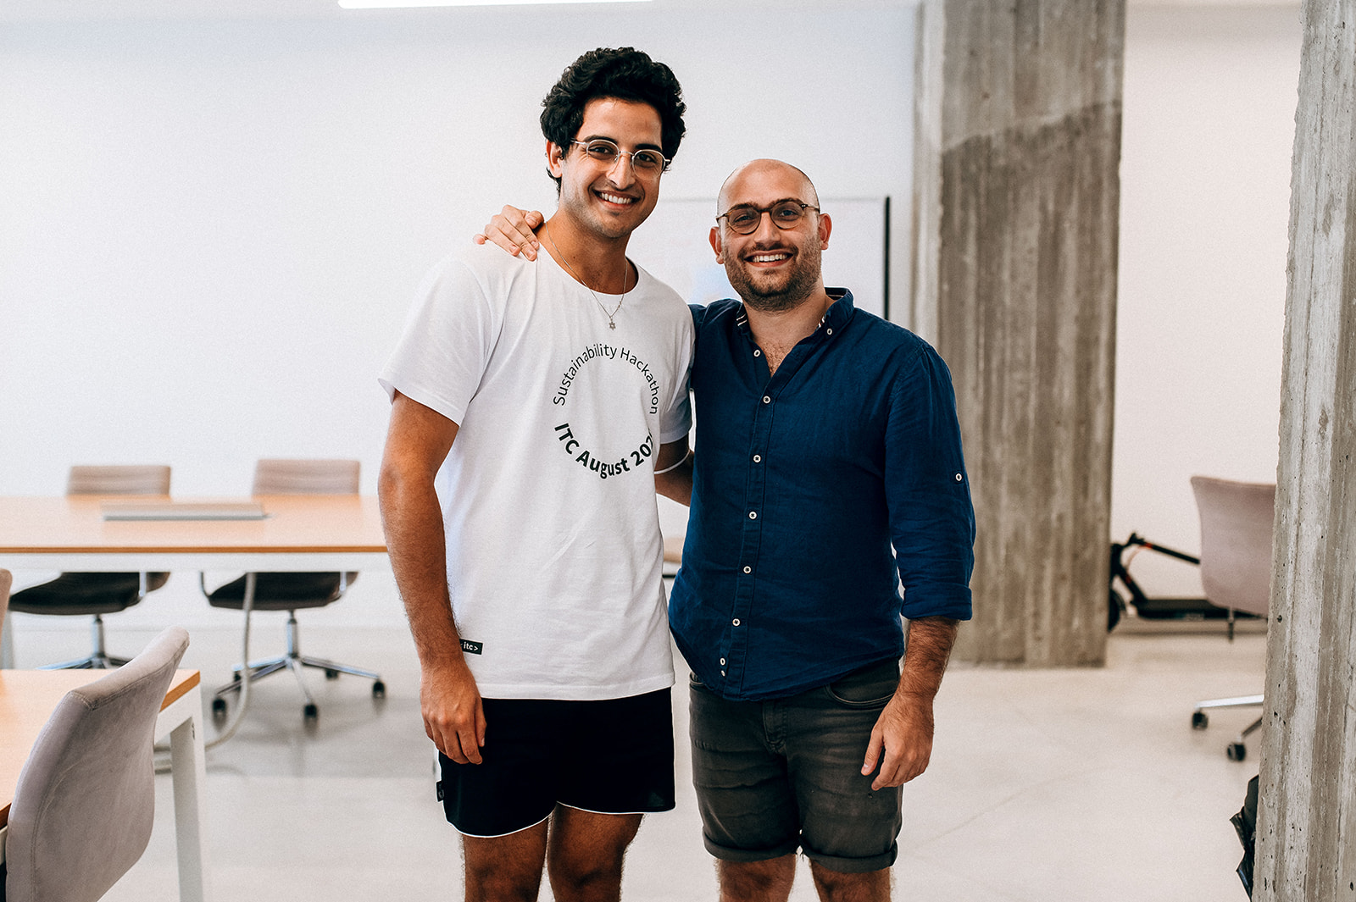

Next Steps
Add more keywords and train on larger datasets
#bitcoin
#datasciencefactory
#sabihlover
#building
#redhead
#ITC
#datascientistsalarygoals
#falafel
#zoombackround
#Gina
#home
#sabih
#Frenchpeople
#topmodels
#vivelafrance

Slide 19
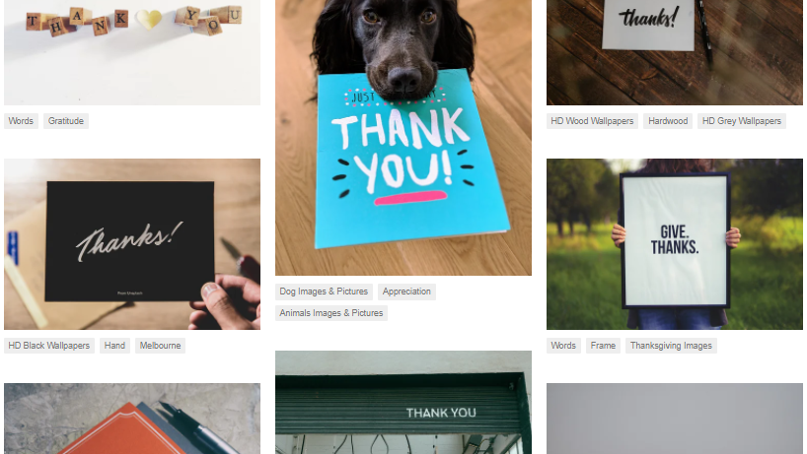
#thankyou

